Slide 1
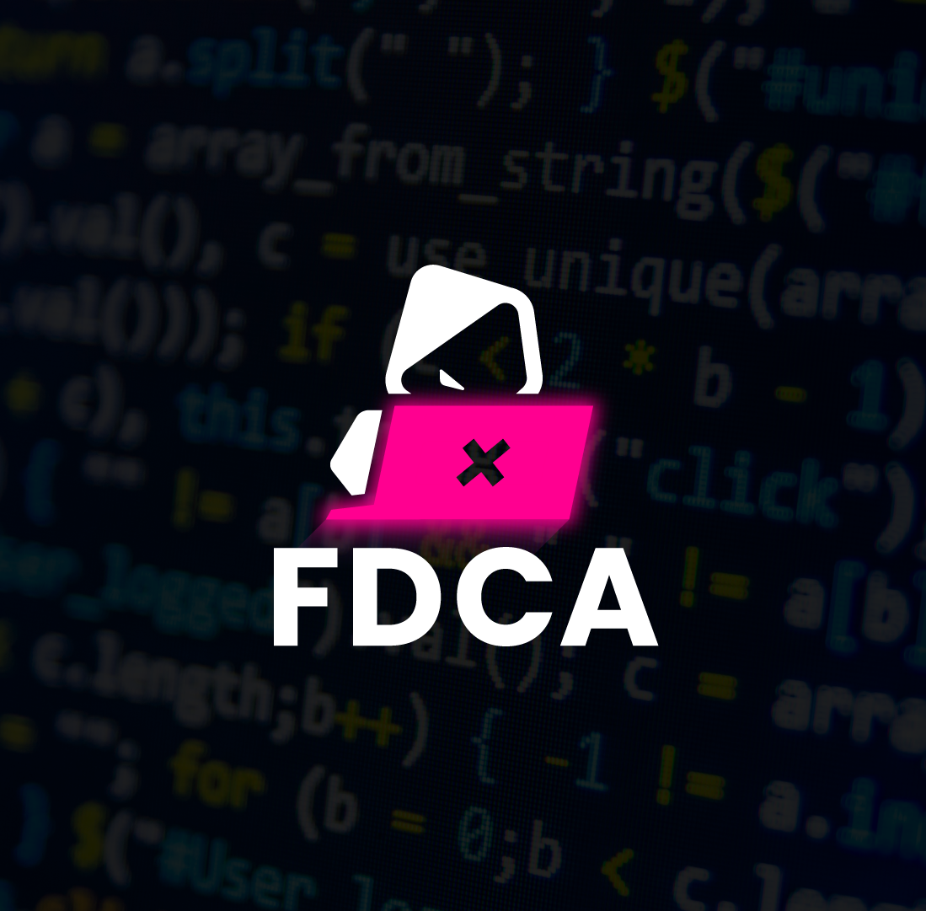
Roll your own DBIR Part 1 – Working with basic metrics
FDCA – Forening for danske cyber alumner
Notes:
Henriksen

Slide 2

Introduction
This is a basic guide and template to “rolling your own DBIR”
The aim is to show you how easy it is to get started with metrics
Based on the VERIS framework
http://veriscommunity.net/
A huge thanks to the team at Verizon for all of their crazy hard work each year on the DBIR.
You are a huge inspiration to a lot of us!
Notes:
Hjortborg

Slide 3
Round 1 – Basic tips
Start basic with your metric gathering
The VERIS framework can act as a great guide for the metrics
However don’t get to bogged down initially in recording “ALL OF THE METRICS”
You need to focus on what will give value for the people reading your “own DBIR”
There is a number of great resources out there regarding getting started with VERIS and DBIR!
https://youtu.be/pdP14wzbqq8 - SolarWinds, Colonial Pipeline - How to collect and share cybersecurity incident data?
Notes:
Hjortborg

Slide 4
Round 1 – Get good at the basics
 | May
Incidents | 12
Security Breaches | 6
This box here is just for counting statistics on the month’s incidents and breaches. An incident is elevated to a breach when the CIA triad has been compromised.
Actions | Incidents | Breaches
Malware | 3 | 0
Hacking | 1 | 1
Social | 7 | 0
Misuse | 0 | 0
Physical | 0 | 0
Error | 5 | 5
Environmental | 0 | 0
Other | 0 | 0
Attributes | May
Confidentiality | 5
Integrity | 1
Availability | 1
This box here is for “attributes” essentially when we are keeping it simple, we are limiting the count to just when part of the CIA triad has been compromised. Multiple parts of the CIA can be compromised in the same breach.
This box is used for recording actions that have been present in incidents and breaches for the month. Remember that multiple actions can have taken place in the same incident or breach.

Slide 5
Round 1 – Bring on the graphs!
You may think that just recording these basic metrics will not give you very much…
But, starting with these you are able to visualize quite a few interesting things…

Slide 6
Roll your own DBIR – Bring on the graphs…
This graph can be used to begin to tell the story about which of your security controls has failed this month.
For example, we can see a high number of incidents involving “Social”, but we see no breaches involving that action.
This could be tied to positive user awareness or email security tools.
It would need further investigation to tell the full story.

Slide 7
Roll your own DBIR – Bring on the graphs…
This graph is one of my favorites, as you can begin to take advantage of these basic metrics over time.
We can see in this graph that there is a big spike from what appears to be our “baseline”. May has been a bad month for our organization.
We can add more graphs to analyze the data further.
Remember this is nothing more complex than recording the basic metrics shown earlier.

Slide 8
Roll your own DBIR – Bring on the graphs…
This graph is a little messy, but I left it in to make the point that you will sometimes end up with graphs that look like this, and need to make the decision about whether you want to have it in your monthly reporting or not.
I would choose to draw some conclusions from the graph and maybe push it into the appendix of the report.
It still tells the story that our organization here has experienced quite a rise in “social”, “error” and “malware” based actions since January.

Slide 9
Thanks for reading! This is just round 1 in the series! Come back for more soon! https://fdca.dk/

